Slide 1
Terraform: First Class IaC in Azure
Mark Gray
Sr Program Manager
Microsoft

Slide 2
Agenda
IaC Tends
Terraform on Azure
Our Commitment
Future

Slide 3
EVERYONE
Safety
Sanity

Slide 4
Infrastructure Goals
Security
Scale
Save money
Flexibility
Deliver Value

Slide 5
Resulting Infrastructure
On-prem
Private Cloud
Legacy
PaaS
First Party
&
Cloud
Public Cloud
IaaS
SaaS
Open Source

Slide 6
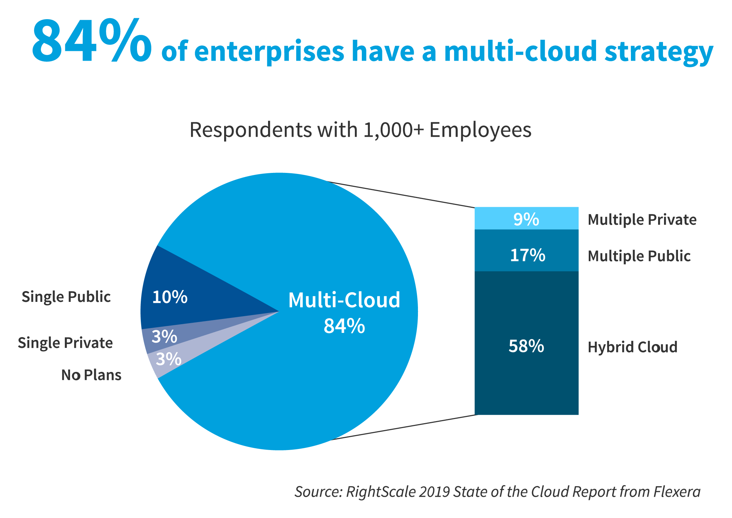

Slide 7
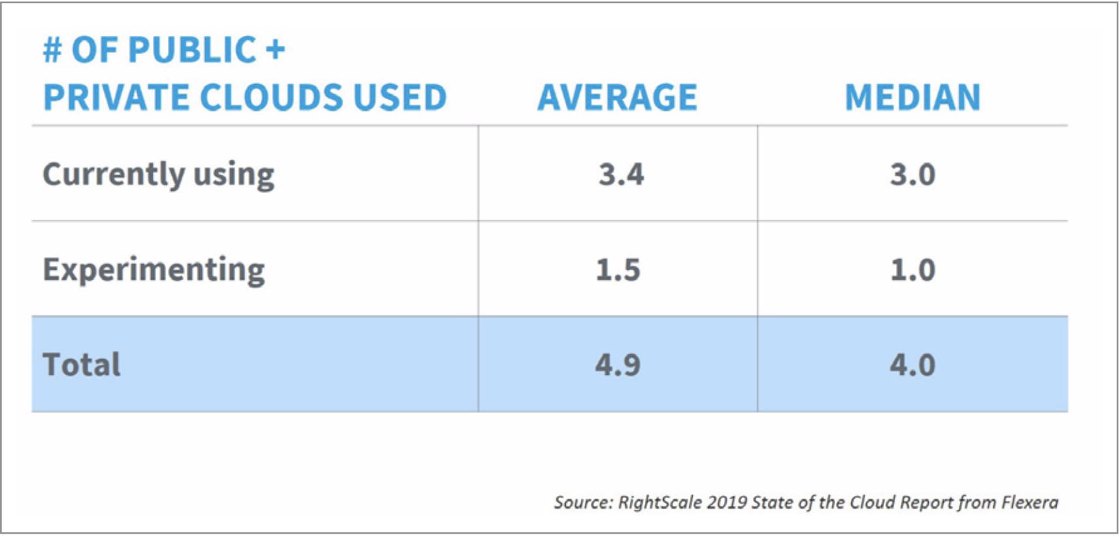
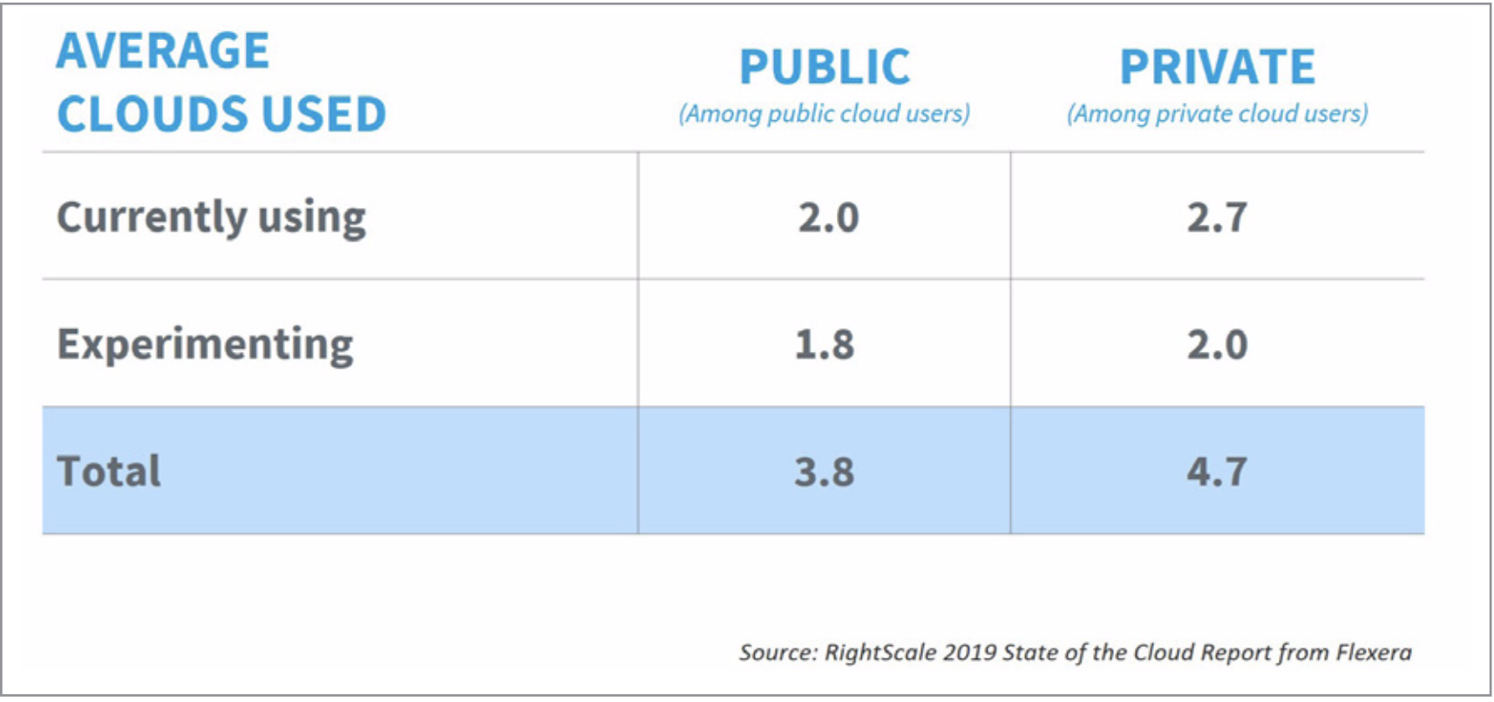

Slide 8
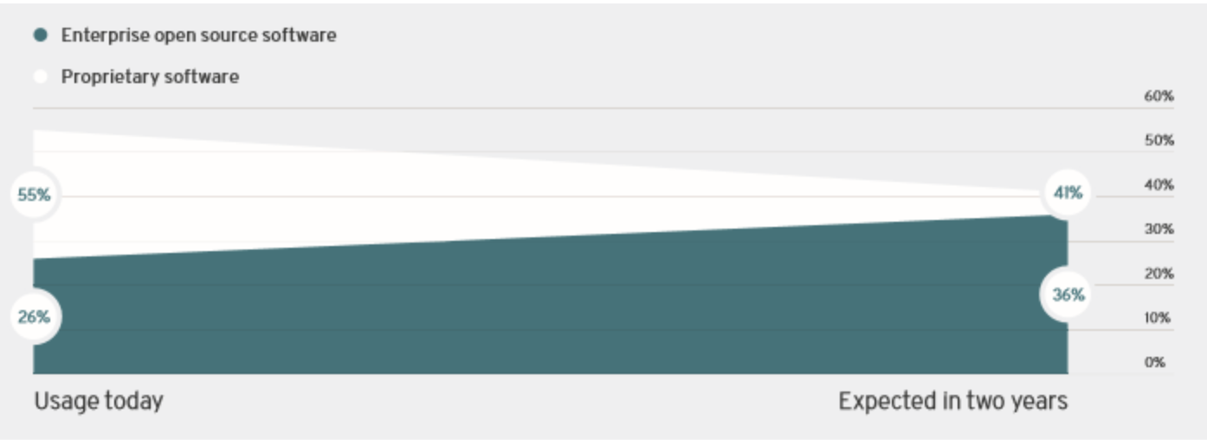
Open Source Trend in Enterprises
https://www.cbronline.com/news/enterprise-open-source

Slide 9
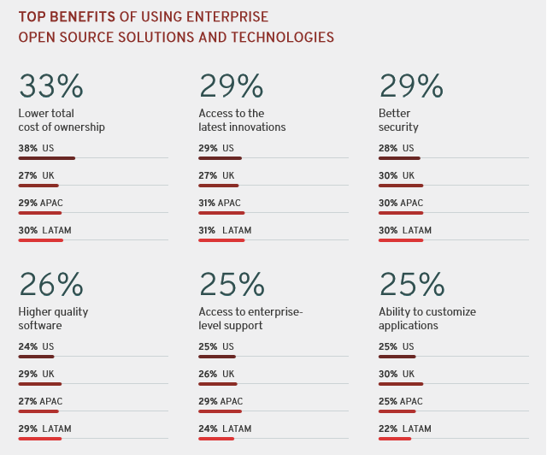
Open Source Benefits for Enterprises
https://www.cbronline.com/news/enterprise-open-source

Slide 10

Notes:
Microsoft embraces Multi-cloud and Open source

Slide 11





Leaders

Slide 12
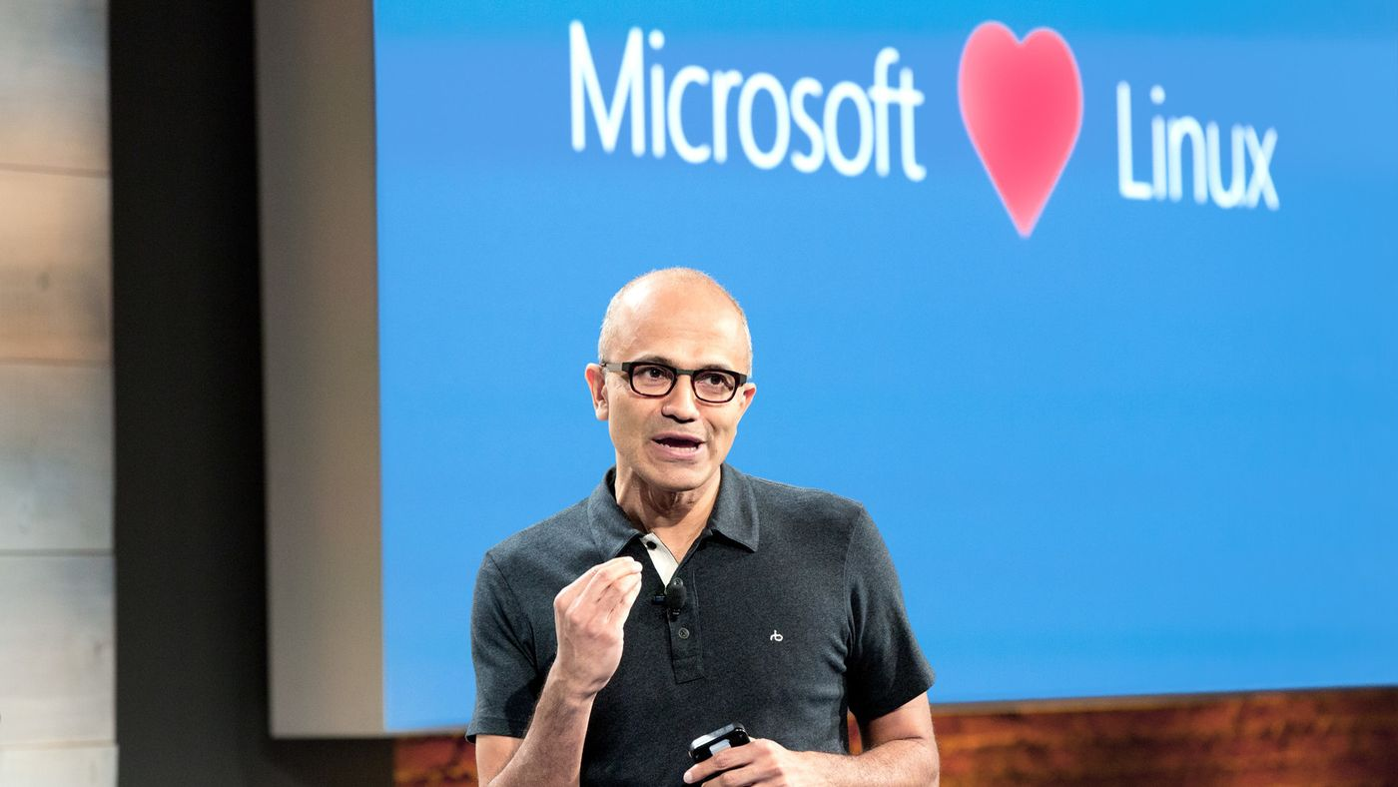
Open source timeline
2018/19
Microsoft acquires GitHub
GitHub contributions
2018
VSCode ranked #1 developer tool (Stack Overflow, 2018 language survey)
Service Fabric Open Sourced
Azure Sphere with Linux kernel
GitHub intent to acquire announced
~5,000 Microsoft employees committing to open source projects on Github
Azure trending to 50% Linux
“Judge us by the actions we have taken in the recent past, our actions today and in the future”
—Satya Nadella, CEO Microsoft
2017
Microsoft Azure Kubernetes Service launched
Draft, Brigade, Kashti projects submitted to Kubernetes community
Microsoft joins Cloud Native Computing & Cloud Foundry Foundations
Azure Database for Postgres & MySQL announced
Azure Databricks (Apache Spark) announced
2016
.NET Core 1.0
PowerShell Core
SQL on Linux announced
Windows Subsystem for Linux in Windows 10
Microsoft joins Linux foundation
2015
VSCode released
HDInsight (Hadoop/ Ubuntu) announced
Microsoft jointly forms Node.js foundation
2014
Satya “Microsoft loves Linux”
.NET foundation created
95,539
314,546
601,886
778,871
314,970 (YTD)
2014
2015
2016
2017
2018
2018

Slide 13
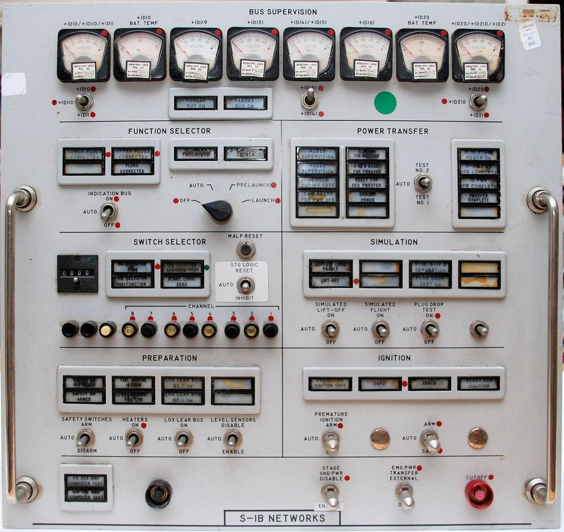

Infrastructure Interfaces

Slide 14

Azure Management Experience (My team)
Make Azure the platform of choice for ALL developers
Meet the developer where they are
Frictionless and productive command line experience for developing and operating on Azure

Slide 15


AME Investments
Now
Next

Slide 16


Slide 17
Partnership & Investment
Multi-year agreement with HashiCorp for collaboration on Terraform providers for Azure
Public milestones and regular release cadence
Tracked publicly in GitHub at
http://github.com/terraform-providers/terraform-provider-azurerm
Releases occur every 1 weeks
Dedicated Azure engineering team
Documentation & tutorials
https://docs.Microsoft.com/azure/terraform
https://learn.hashicorp.com/terraform?track=azure#azure
Microsoft 1st line Support
Currently 2PM + 7 MS engineers, 6 HashiCorp engineers
Microsoft PM owns prioritization of incoming customer issues

Slide 18
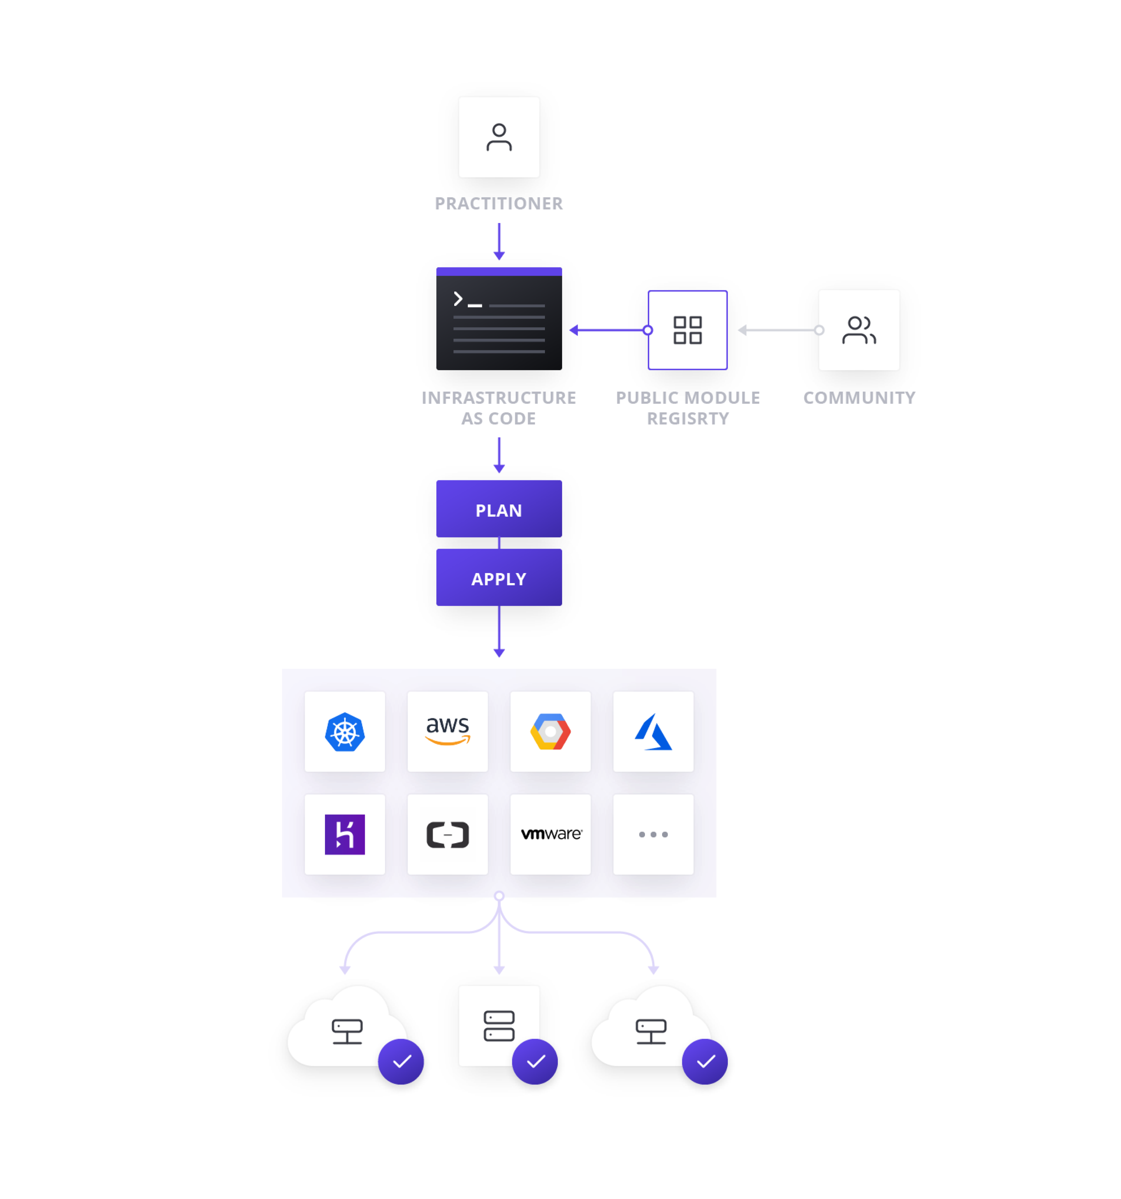

Slide 19
Infrastructure as Code
Reproducible Environments
Automation – CI/ CD
Trackable – GitHub
Language - HCL
Workflow
Providers
Apply same config across clouds

Slide 20
Terraform State
Required
Purpose
Map config to “real world”
Create Plan
Update “real world”
Contains
Managed Infrastructure mapping
Values
Configuration
Metadata - dependencies
Types
Standard
Enhanced

Slide 21
Backends
Default
local
Standard Remote
AzureRM (Blog storage), Artifactory, Consul
Enhanced Remote
Terraform Cloud, Terraform Enterprise

Slide 22
Providers
Defines how Terraform will interact with:
Cloud
Azure
AWS
Google
AliCloud
OpenStack
Infrastructure
Kubernetes
Docker
Rancher
Network
DNS
Cloudflare
HTTP
Version Control
GitHub
GitLab
Bitbucket
Monitoring
DataDog
Grafana
PagerDuty
Database
InfluxDB
MySQL
PostgreSQL
Etc.
Notes:
A provider is responsible for understanding API interactions and exposing resources. Providers generally are an IaaS (e.g. AWS, GCP, Microsoft Azure, OpenStack), PaaS (e.g. Heroku), or SaaS services (e.g. Terraform Enterprise, DNSimple, CloudFlare).

Slide 23
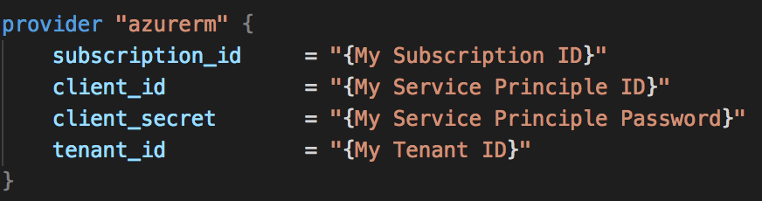
Azure Provider
Authentication
Azure CLI
Service Principal
Managed Instance
Arguments
Environment Variables

Slide 24
Demo 1
Notes:
HCL & VS Code extensions
State initialization
Plan
Azure Cloud Shell
HCL (describe language simplicity) - https://www.terraform.io/docs/configuration/syntax.html
Show Terraform Azure Provider docs - http://aka.ms/terraform
Show VSCode with Extensions
Syntax highlighting
CloudShell - http://portal.azure.com
terraform
Code .
Syntax highlighting

Slide 25
Workflow
Init
Plan
Apply
Destroy

Slide 26

Resources & Data Sources
This Photo by Unknown Author is licensed under CC BY-SA-NC

Slide 27
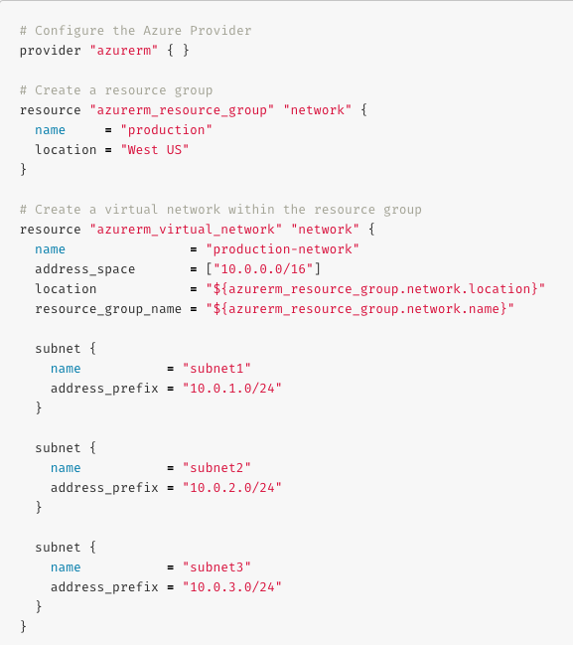
Azure Resources & Data Sources
Provisioning for Azure IaaS
Compute (VMSS, Disk, Image, Snapshot, …)
Networking (Vnet, LB, DNS, …)
Azure Active Directory
Database (MySQL, PostgreSQL, SQL)
Monitoring
Storage (Storage Account, Blob, Share, …)
…
Provisioning for Azure PaaS
Containers (AKS, ACI)
Web Apps
CosmosDB
Data Lake
Logic Apps
KeyVault
…
Catch-All
ARM Template

Slide 28
Expressions
Reference information from resource or data source
Dependencies
Order of operations
Implicit
Explicit

Slide 29
Demo 2

Slide 30
Variables
Secrets
Definition
variable “{variable_name}” { …}
Declaration
terraform.tfvars
Prompt
Command line
Usage
var.{variable_name}
What
tokens, passwords, connection strings, certificates, encryption keys, etc.
Where
AWS Secrets Manager, Azure Key Vault, HashiCorp Vault, Google Secret Manager
Usage
Data source

Slide 31

Helpers
Iterators
Count
Dynamic Blocks
Built-in Functions
Networking
String formatting
Filesystem
Conditional
condition ? true_val : false_val

Slide 32
Demo 3

Slide 33

Abstraction Modules

Slide 34
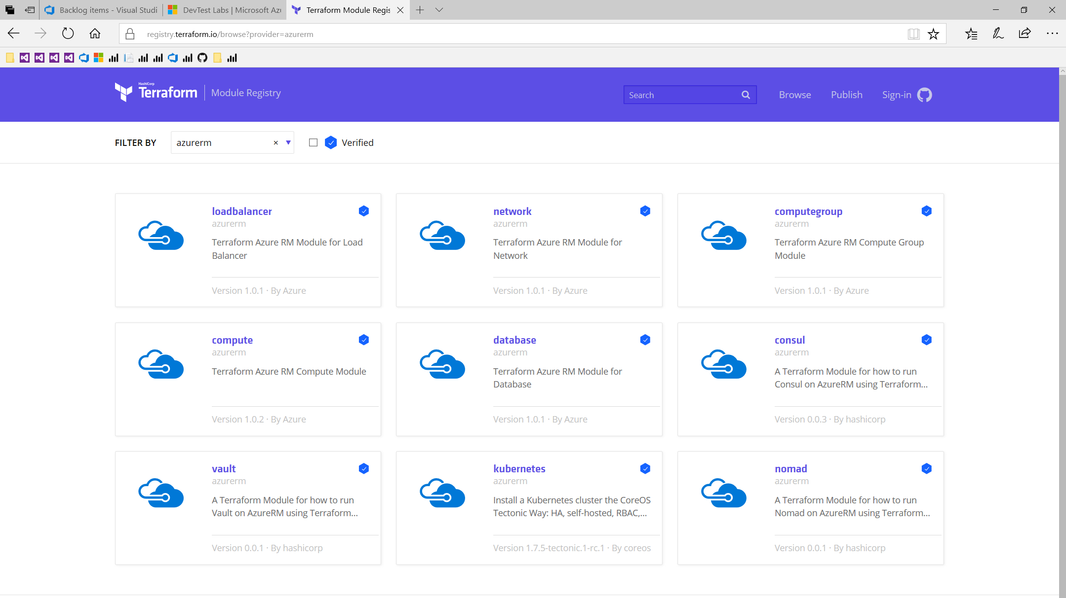

Slide 35
What’s Next

Slide 36
Terraform Future
100% coverage of Azure services
SLA for Terraform coverage for new services and features
Centralized team working on entire Azure surface area

Slide 37
Satya quote
“Judge us by the actions we have taken in the recent past, our actions today and in the future”
—Satya Nadella, CEO Microsoft
2014
2018
2015
2016
2017

Slide 38


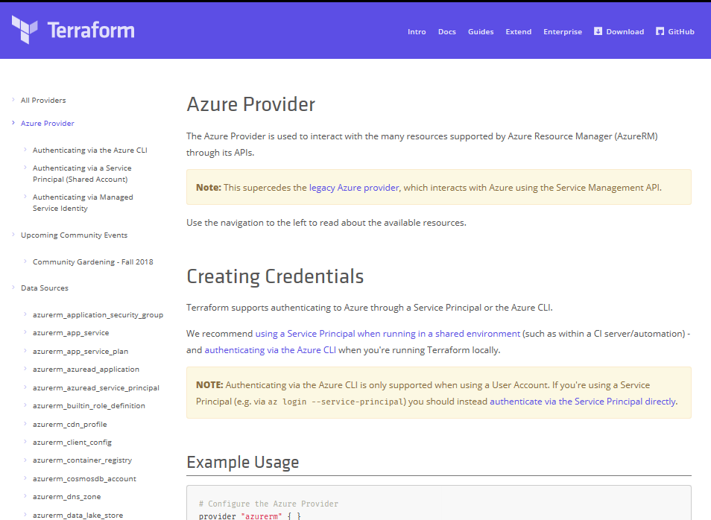
Terraform
Azure DevOps Tool Integrations
Bringing native Azure support for customers using Terraform
Documentation Hub for Terraform
Terraform in Azure Cloud Shell
Azure Resource Provider
Azure Module Registry
Azure Cloud Shell Integration
➔
docs.microsoft.com/azure/terraform
© Microsoft Corporation

Slide 39
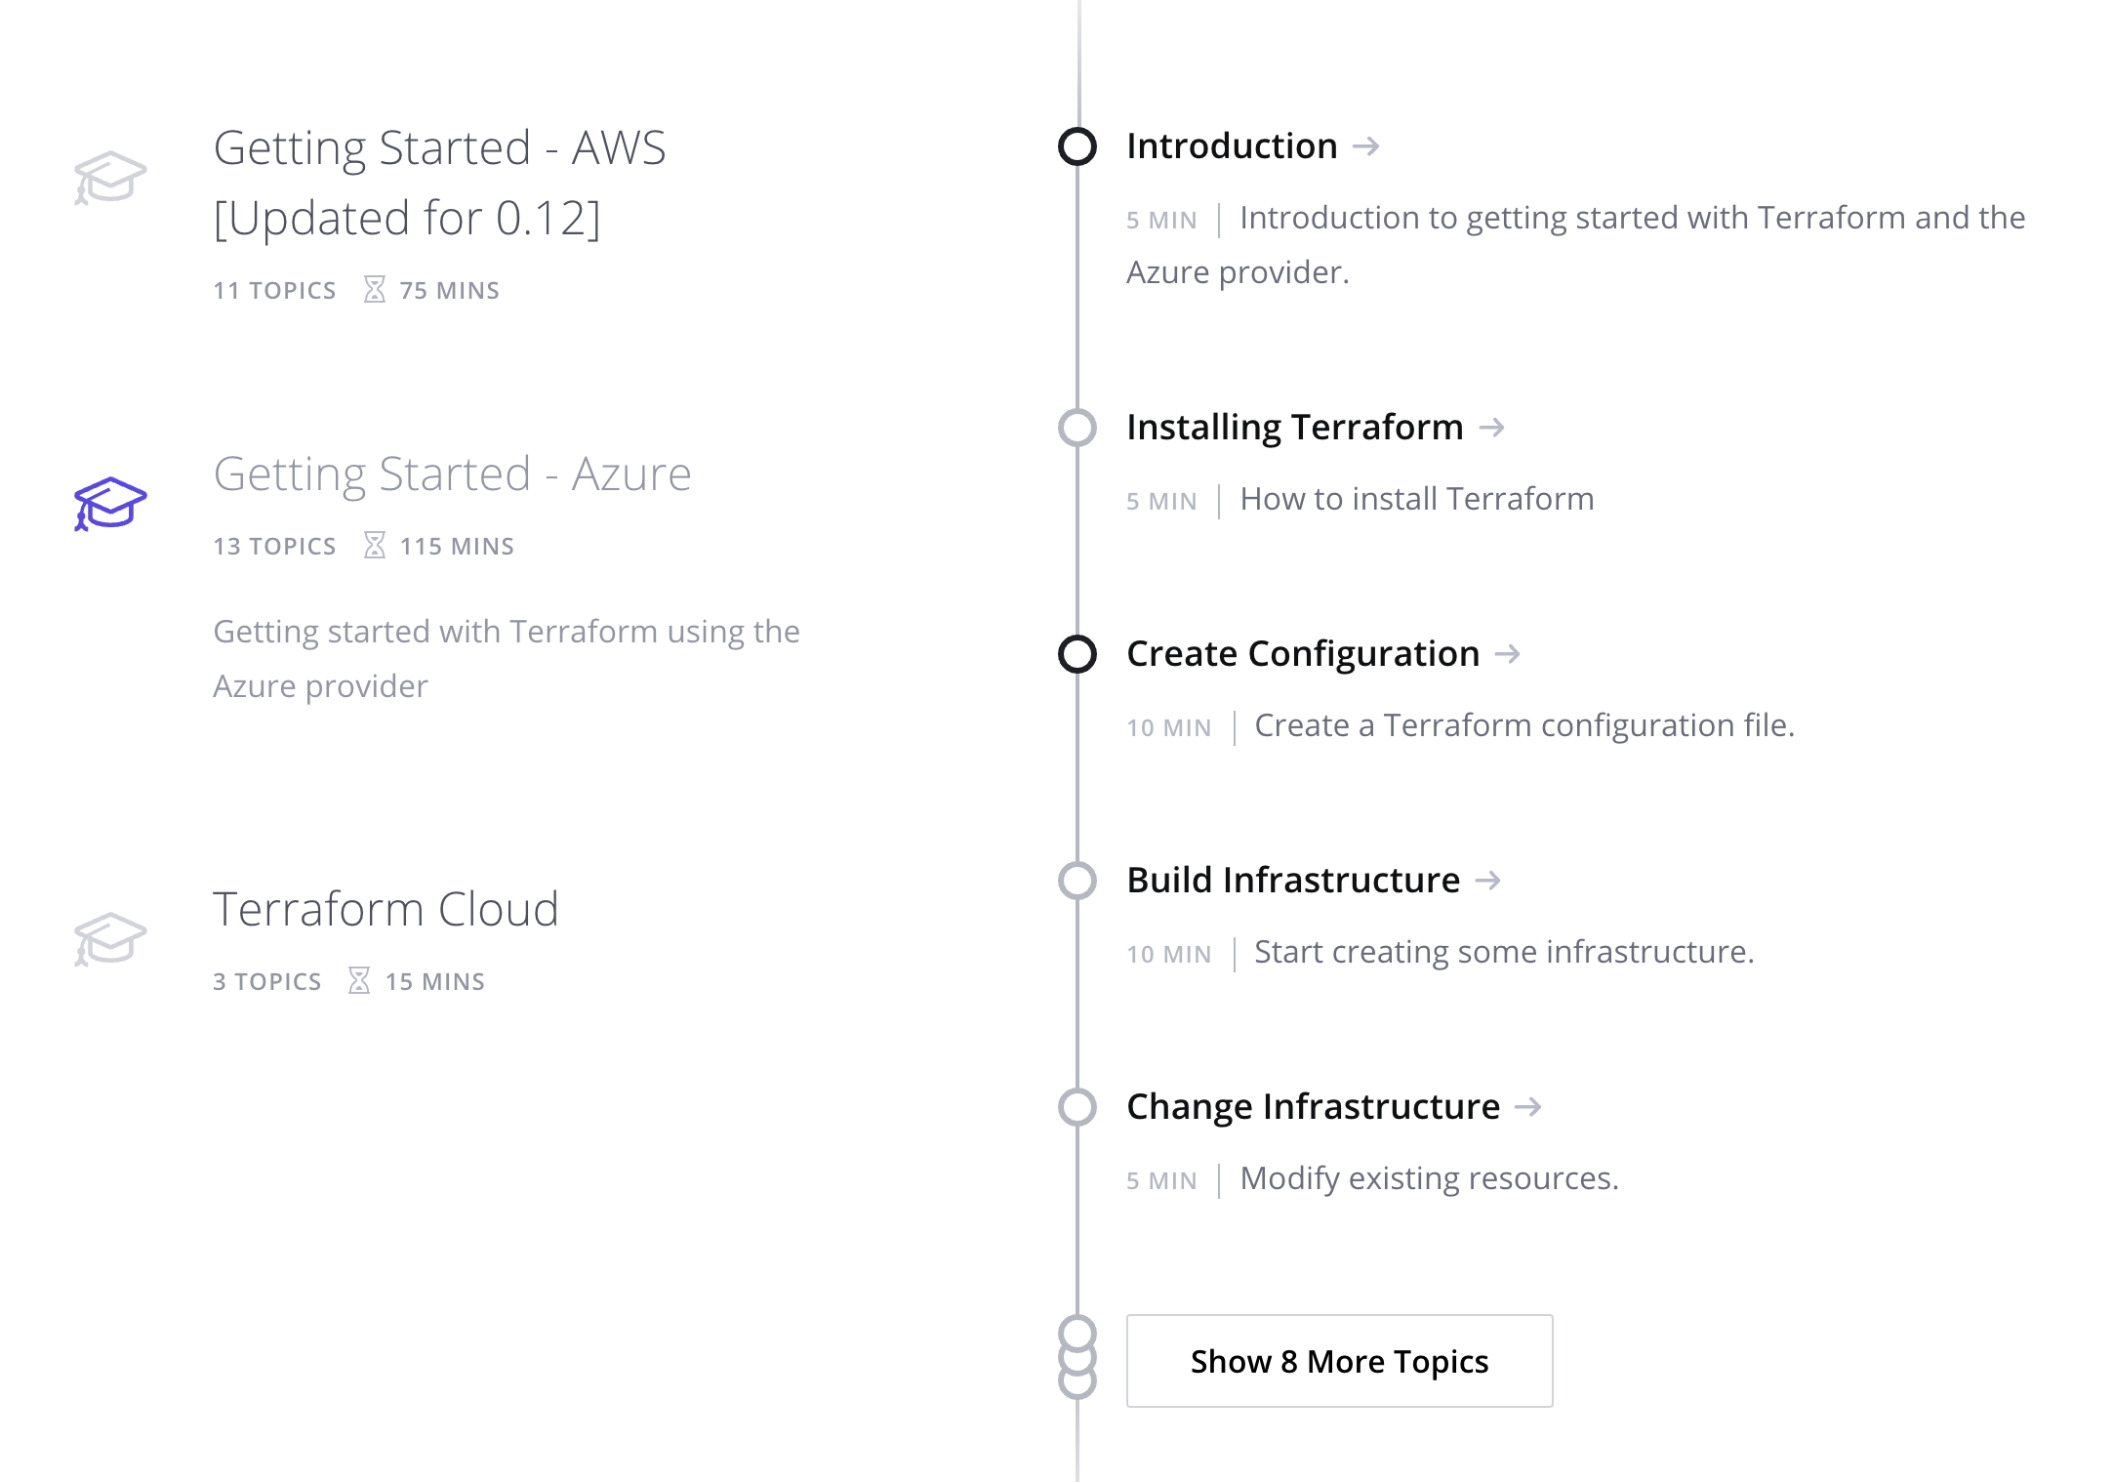
https://learn.hashicorp.com/terraform/?track=azure#azure

Slide 40
Session resources
Docs – http://aka.ms/terraform
Code – http://aka.ms/tfgit
Articles – http://aka.ms/tfhub
Solution – http://aka.ms/azdotf
Advisors – email me (mark.gray@Microsoft.com)
tweet me (@markg_msft)

